Slide 1
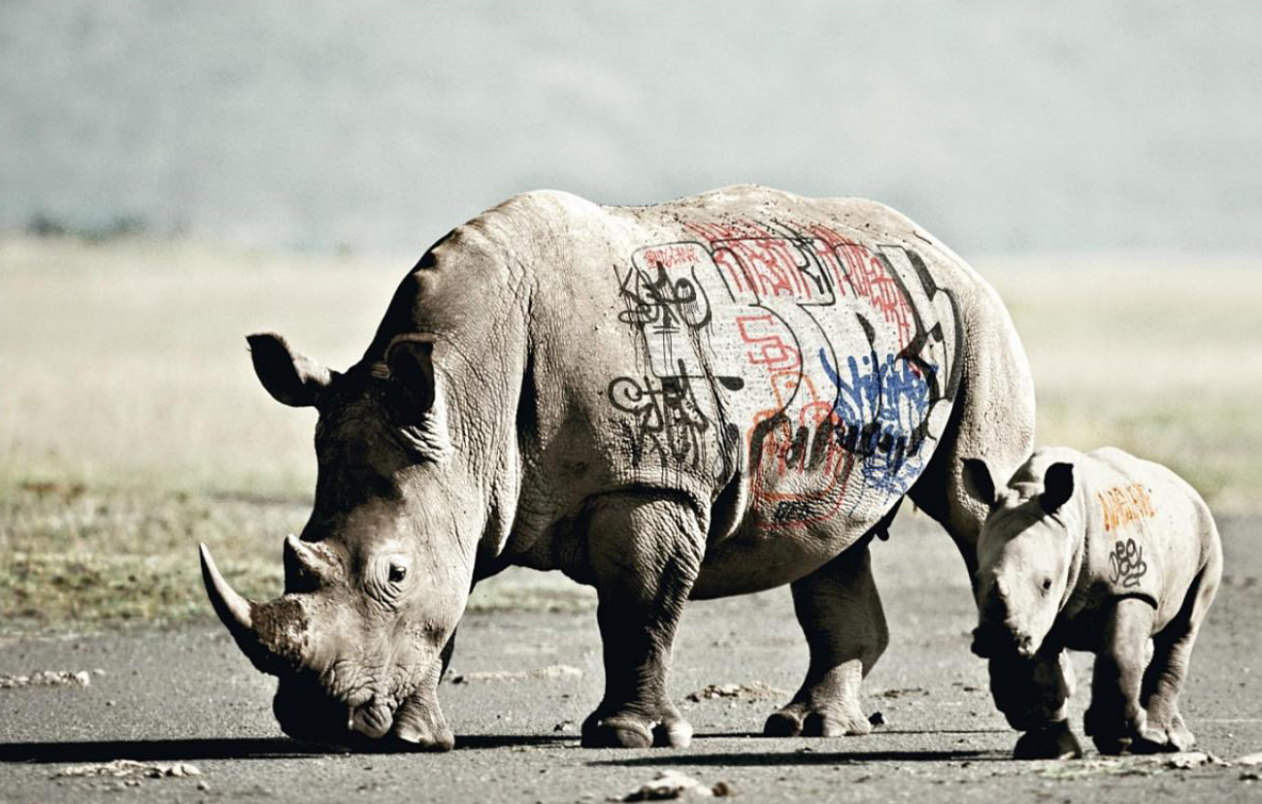
The future of biodiversity

Slide 2
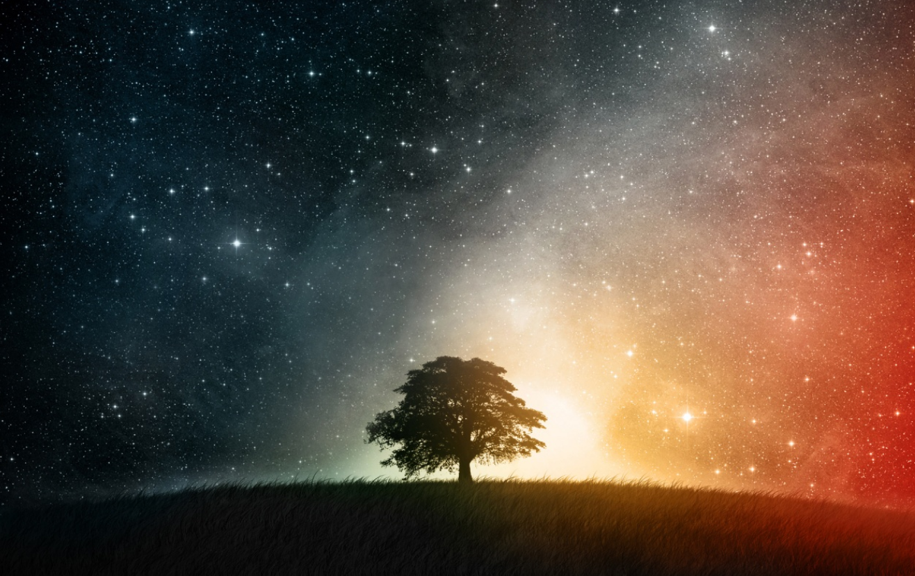
Putting the problem in perspective
As many a 100 billion Earth-like planets
~ 10 meet Earth's life conditions
Probability of life in the universe= ~0.00000000001

Slide 3
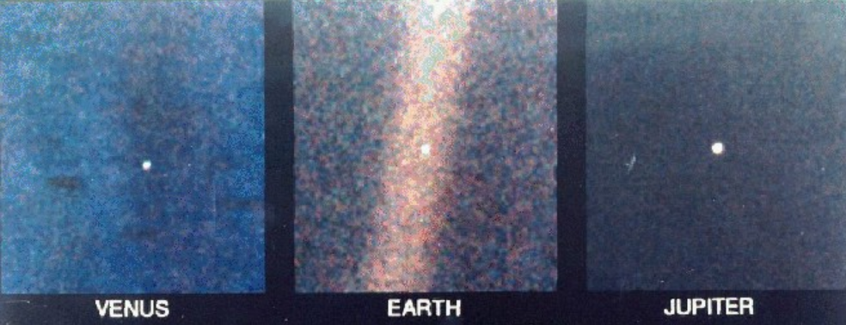
So insignificant yet so important
Voyager 1 spacecraft photos

Slide 4
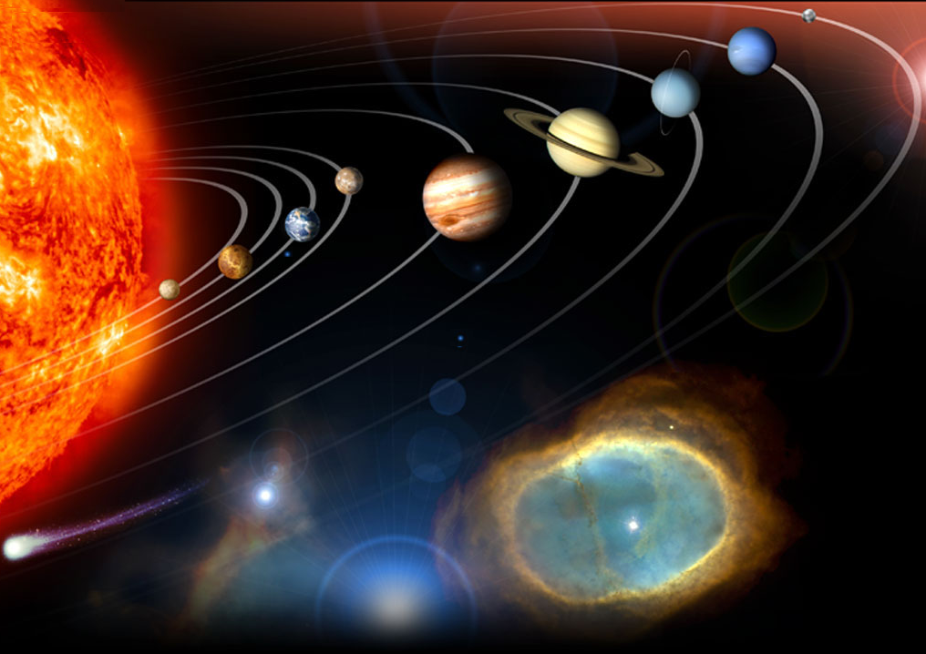
The conditions for life were just right
2. A terrestrial planet
1. Source of constant and stable energy
3. The right distance from the energy source
To cool
To hot
4. Need a satellite star
5. Near circular orbit
6. The right place in the galaxy
7. Carbon and oxygen
8. Magnetic shield
Notes:
Requirements for life
a solar system with a single massive Sun than can serve as a long-lived, stable source of energy
a terrestrial planet (non-gaseous)
the planet must be the right distance from the sun in order to preserve liquid water at the surface – if it’s too close, the water is burnt off in a runaway greenhouse effect, if it’s too far, the water is permanently frozen in a runaway glaciation
the solar system must be placed at the right place in the galaxy – not too near dangerous radiation, or to be absorb by their gravity
a moon of sufficient mass to stabilize the tilt of the planet’s rotation
A near circular orbit to maintain water in its surface
an oxygen-rich atmosphere
a sweeper planet to deflect comets, etc.
planetary neighbors must have non-eccentric orbits to avoid collitions
Carbon for encoding biological information to allow it to replicate itself. The only element in the periodic table that allows you to encode information is carbon.
Oxigen to fuel metabolisms and independence of organinms
http://winteryknight.wordpress.com/2009/04/02/what-conditions-are-needed-to-create-a-habitable-planet/
http://www.arn.org/docs/gonzalez/gg_arewealone.htm

Slide 5
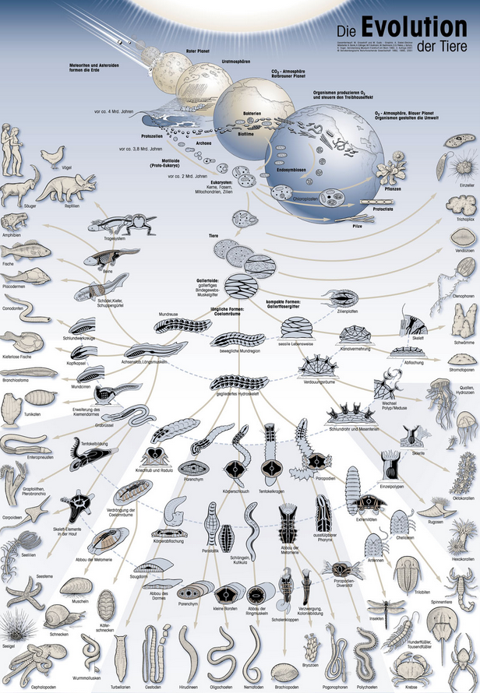
Evolution: the species generation machine

Slide 6

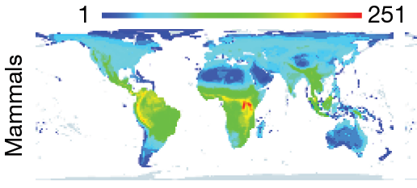
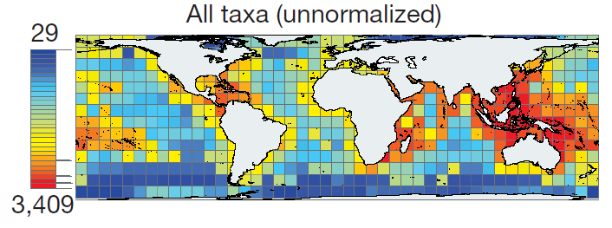
And the all these bulk of species got to be almost every where
On land
Grenyer et al. Nature 2006
and sea
Tittensor et al. Nature 2010

Slide 7
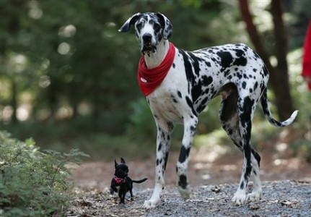
And they got to have all sorts of sizes

Slide 8
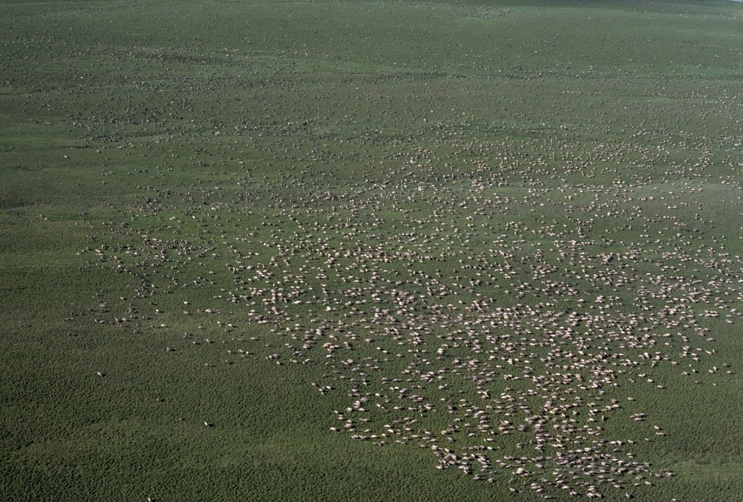
And on all types of abundances as well

Slide 9
Bu then, it was us
..very insignificant in the time line of life on Earth…

Slide 10
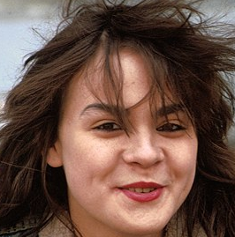
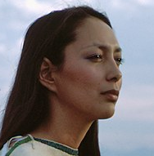
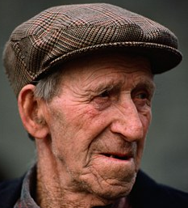
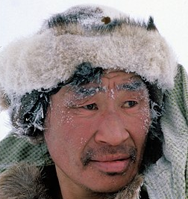
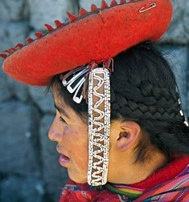
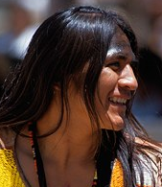
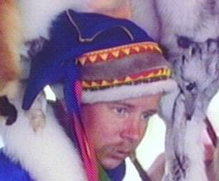
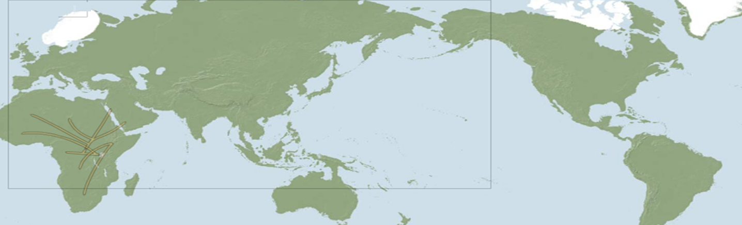
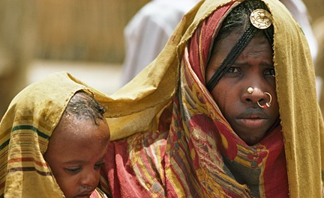
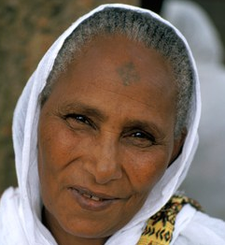

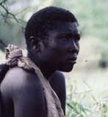
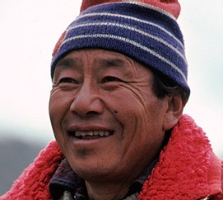
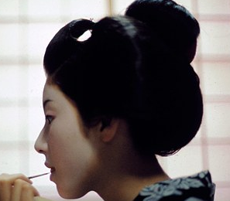
Starting from a single place got to be everywhere
Haplogroup R
Undetermined
Haplogroup A
50,000 BC
Haplogroup M343
35,000 BC
Haplogroup M242
15,000 BC
Haplogroup B
60,000 BC
Haplogroup M3
10,000 BC
Haplogroup M231
Undetermined
Haplogroup L0
100,000 y ago
Haplogroup L3
80,000 y ago
Haplogroup M*
60,000 y ago
Haplogroup M91
55,000 y ago
Haplogroup M174
50,000 y ago
Haplogroup F
Undetermined

Slide 11
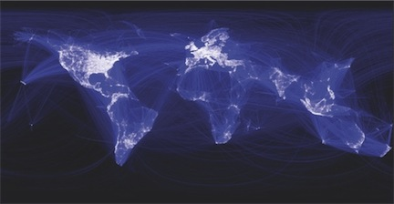
But we great distribution and abundance comes great impact

Slide 12
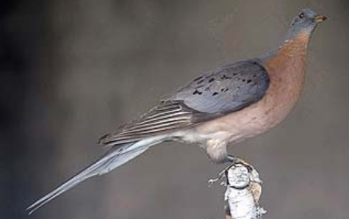
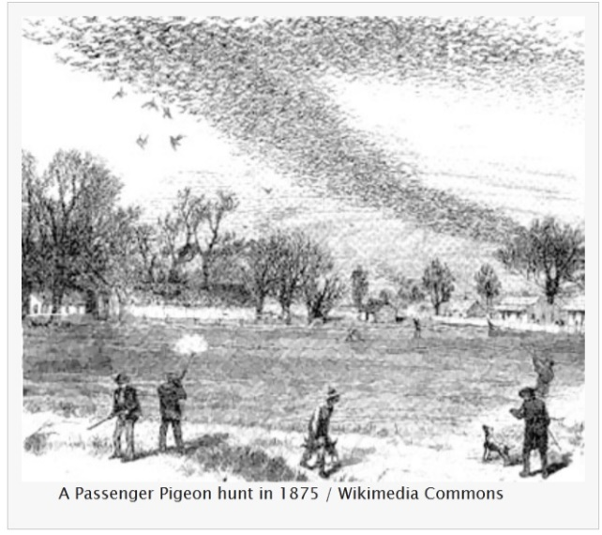
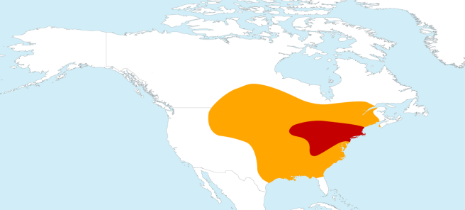
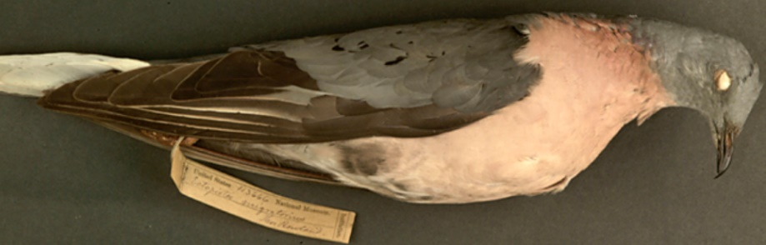
…once very abundant and broadly distributed species start disappearing..
Passenger Pigeon (Ectopistes migratorius)
100 years
The evidence that it once existed

Slide 13
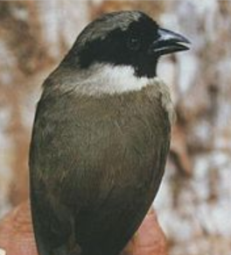
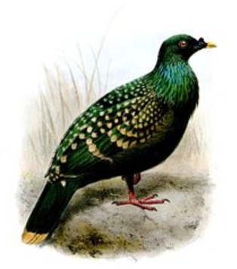
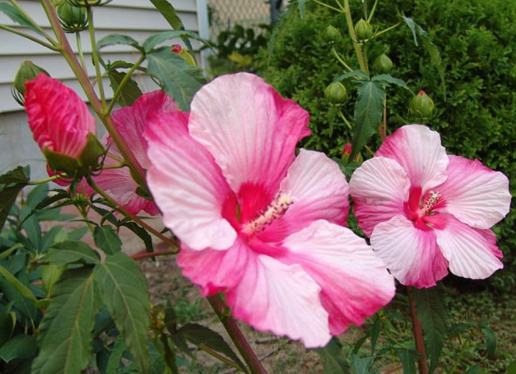
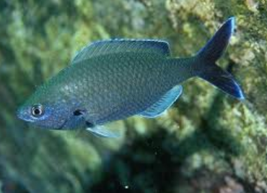
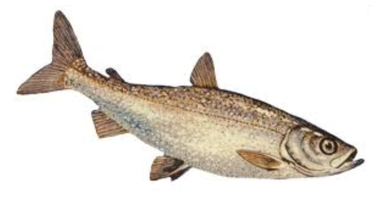
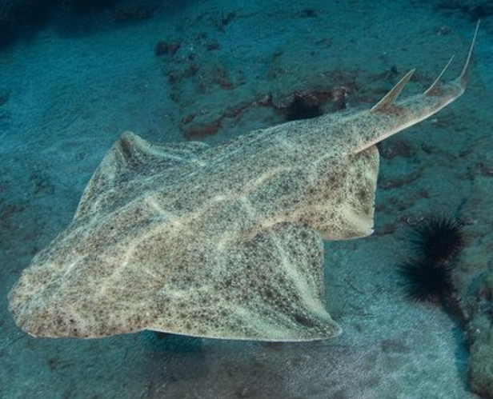
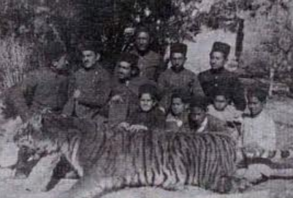
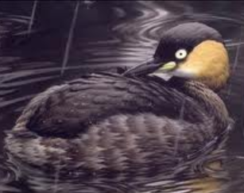
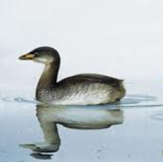
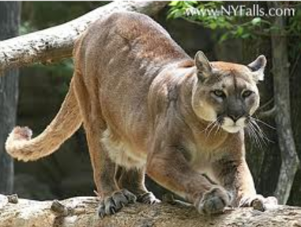
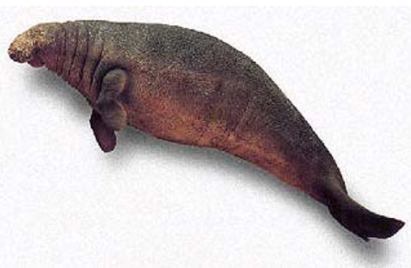
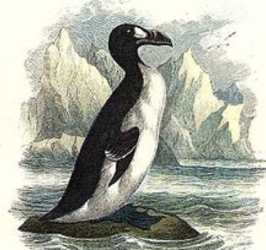
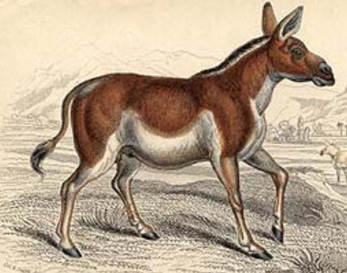
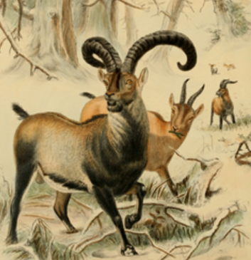
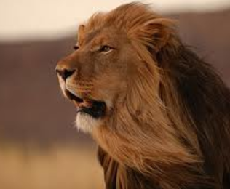
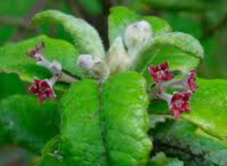
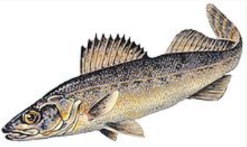
Few others no longer with us…
Puhielelu Hibiscadelphus
Hawaiian Honeycreeper
Black Spotted Damselfish
Liverpool Pigeon
Angel shark
Bezule
Caspian tiger
Alaotra Grebe
Atitlán Grebe
And just like that some other 20,000 gone every year
Eastern Cougar
Extinct 1981
Extinct 2004
Extinct 1970
Extinct 2008
Extinct 2011
Extinct 1930
Steller's Sea Cow
The Quagga
Great Auk
Pyrenean Ibex
Cape Lion
Extinct 2010
Extinct 1970
St. Helena Olive
Extinct 1989
Blue walleye
Extinct 2011
Extinct 1741
Extinct 1900s
Extinct 1840
Extinct 2000
Extinct 1963
Extinct 2003
Extinct 1983

Slide 14
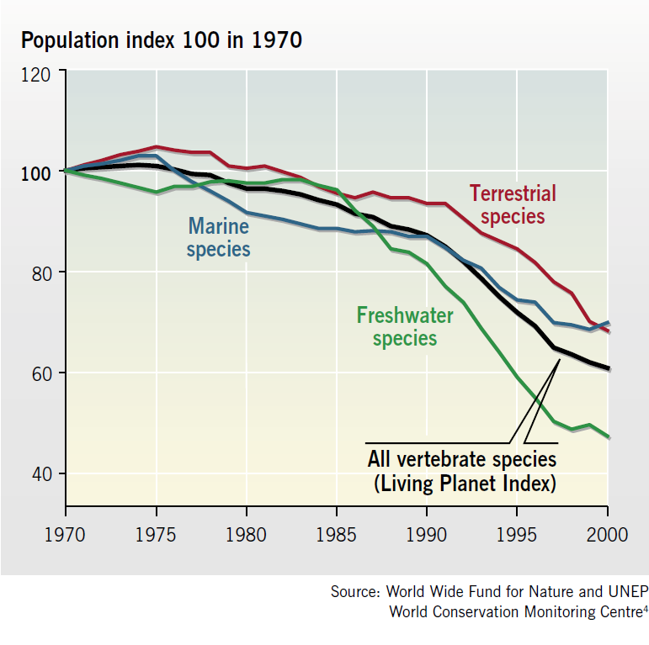
Their abundances declining
Some ~3000 monitored populations have declined about 40% between 1970 and 2000
- Inland water species declined by 50%
- Marine and terrestrial species declined by 30%

Slide 15
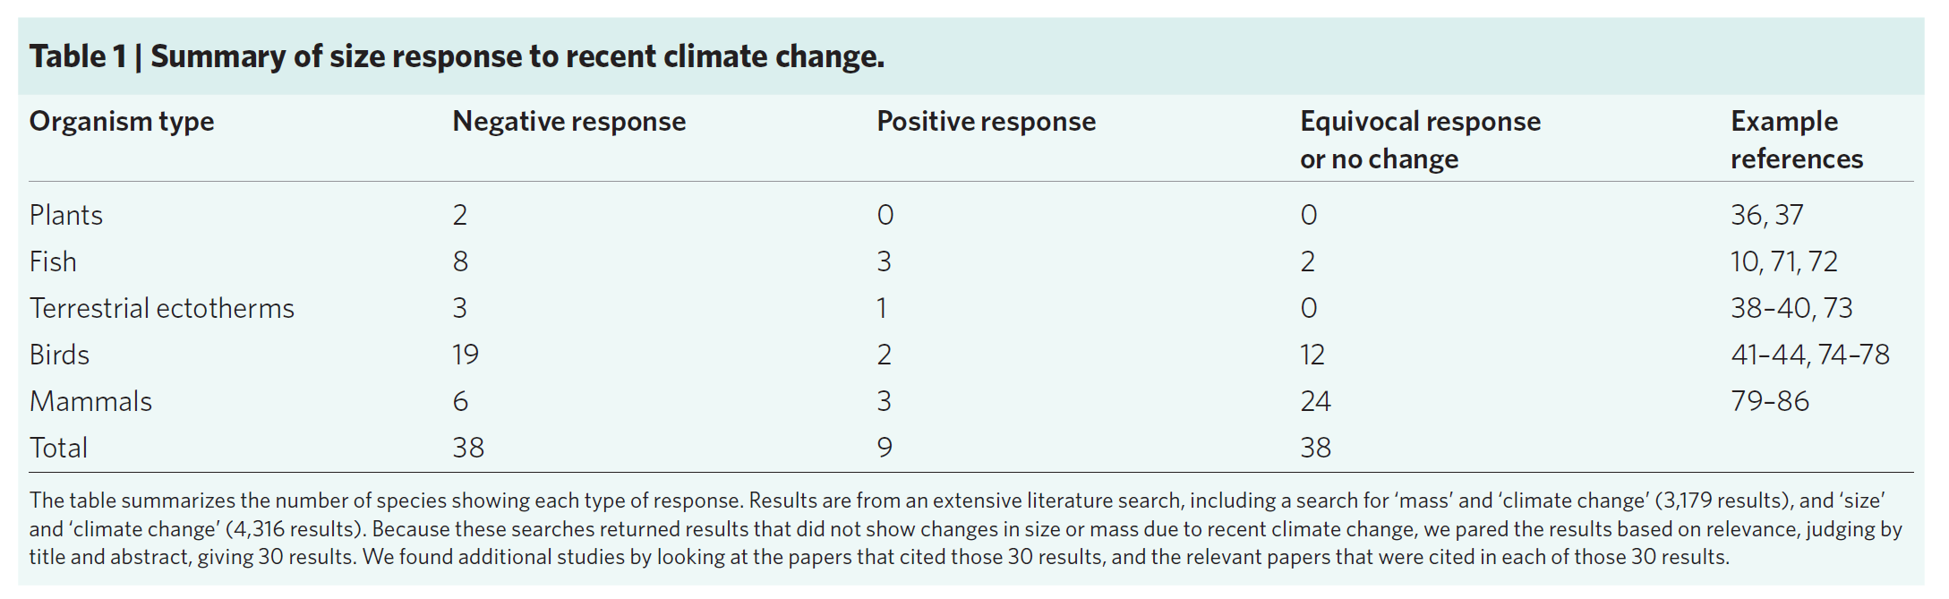
And their body sizes shrinking
Cheung et al. Nature Climate Change 2012

Slide 16
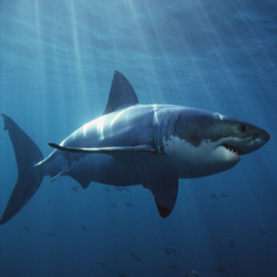
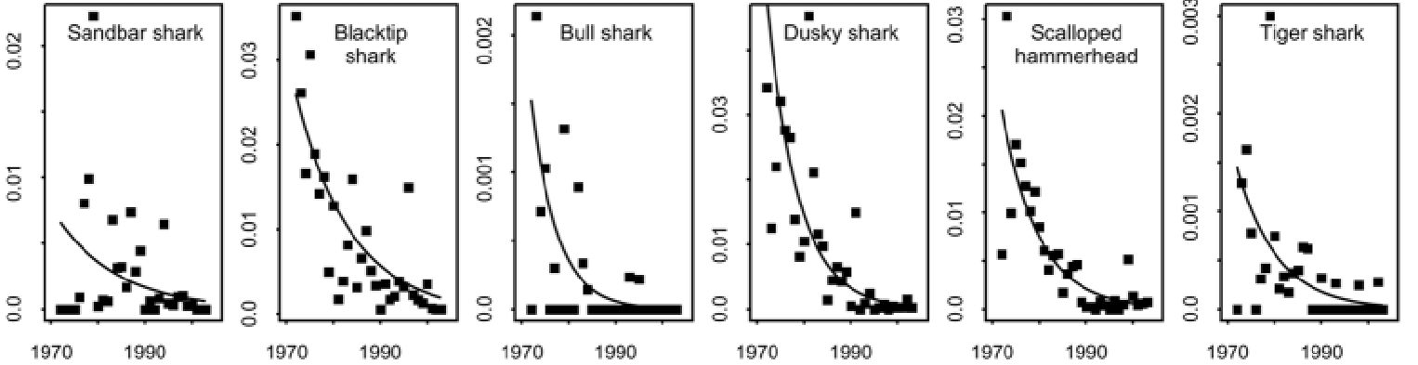
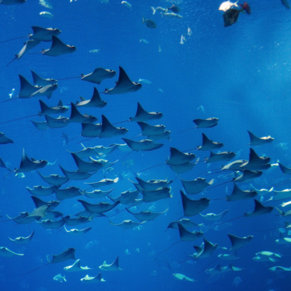
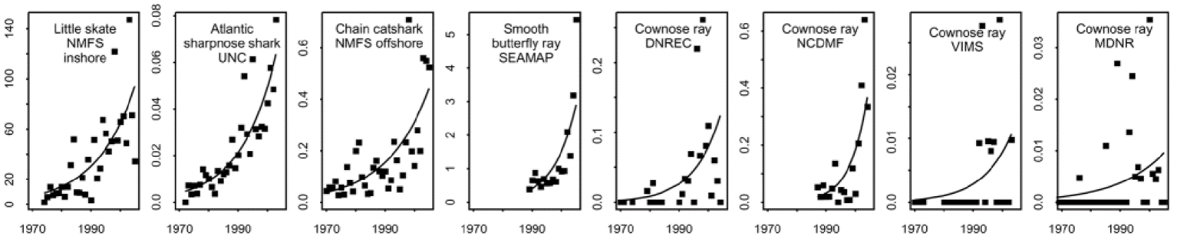


Impacts are beyond single species: Tropic cascades
Populations are part of communities so the effect of their depletion can dissipate to entire communities and ecosystems (i.e. Trophic cascades)
Myers et al (Science 2007)

Slide 17

Impacts can be definitive
Alternative equilibrium states
Bellwood et al., Nature 2003
Stressor
Some of the damages from overexploitation can be definitive
Depensation
Genetic loss

Slide 18


Unfortunately, evidence suggestion we may not do much to reverse the crisis
Environmental generational amnesia
Shifting baseline
Generation X
Biodiversity
Generation Z
Time

Slide 19


And even more a predicted to go extinct
8 mil ?
5 mil ?
0.22% / y
0.72% / y
Mass extinction event
Mora et al., Science (2013)

Slide 20









And we start discovering why: Overexploitation
exploitation of a wild population beyond its natural level of replenishment

Slide 21









And we start discovering why: Habitat loss
Reduction of hospitable locations for individuals of a species

Slide 22

And we start discovering why: Climate change
Hoegh-Guldberg & Bruno., Science 2010

Slide 23



And we start paying attention
Butchard et al (Science 2010)

Slide 24
So what is the problem?
Human population
Household
Food
Energy
Habitat loss
Overexploitation
Climate change: Warming, Acidification
Pollution: sewage, erosion, eutrophication
Invasive species
Protected areas
Quota limits
CO₂ caps
Alternative energies
Education awareness
Treatment plants
Manual controls
Traffic reduction
Biodiversity status

Slide 25



And what’s the future?
12 in Saudi Arabia
9 in the USA
0.68 in Haiti
x Average per capita consumption: 2.1 global hectares a year
/Earth’s biocapacity: 11 billion global hectares a year
Overshoot
All Earth’s biocapacity already consumed
Mora & Sale, MEPS 2011

Slide 26
We are screw

